Slide 1
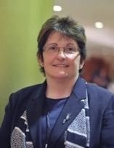
Our charity
Chair of Trustees
Brian Lamb OBE
Founder & CEO
Prof. Sonia Blandford
Notes:
The charity was formed on the back of a very successful pilot from 2009 – 2011. This pilot came from Brian Lambs enquiry into Parental Confidence and engagement for parents with children with SEND. His recommendations have helped shape the current SEND agenda and did kick start the Achievement for All pilot across 10 Las in England. The success of the pilot led to the formation of the Achievement for All Charity by Sonia Blandford, the pilot director. Once established Brian himself became chair of the Trustees.
Since the Charity’s formation in 2011 we have been recommended nationally for the work undertaken. Most recently being awarded School Improvement Service of the Year by Education Inverstors

Slide 2
Our charity
Our vision
A world in which all children and young people can achieve regardless of their background, challenge or need
Our mission
Transforming lives through improved educational opportunities and outcomes for children and young people vulnerable to underachievement

Slide 3
Who we are & what we do…
Achievement for All works at every stage of the education system, supporting children from two-19 years of age, with bespoke partnerships delivered across our core flagship programmes.
The Achieving Schools programme works closely with primary, special secondary and free schools to dramatically enhance the goals and outcomes of their pupils. Together we address the issues faced by children and staff, changing lives for the better through the four key areas of Leadership; Teaching and learning; Wider outcomes and opportunities and Parent and carer engagement.
www.afaeducation.org
Twitter: @AfA_Education
Facebook: AfAEducation
YouTube: https://www.youtube.com/watch?v=WXuTRPP3MXI
Notes:
ASPIRATIONS ACHIEVEMENTS IMPACT That’s where the 3As come from!
The Charity’s Vision:
A world in which all vulnerable and disadvantaged children and young people can develop their skills, interests and capabilities to achieve.
The Charity’s Mission:
To transform the lives of vulnerable and disadvantaged children, young people and their families by raising educational aspirations, access and achievement.
The book cover shown was published in June 2013, and tells the story of the charity and summarises some of its key principles and strategies.

Slide 4
Aims of session
To introduce the STEEP as a tool for understanding and overcoming barriers
To look at barriers and solutions for CLA
To share case studies of this work in practice
Notes:
5 mins

Slide 5
Improving Educational Outcomes for Children Looked After
Across the 2014-15 academic year, we collected data produced as part of twenty STEEP sessions and conducted a thematic analysis of the barriers and solutions identified.
Various models of STEEP analysis completion and groupings have been used during the programme including:
Single and multi stakeholder groups including CLA, care leavers, foster carers, teachers, virtual schools, social workers and the wider professional network
Primary and secondary schools joint meetings with a focus on transition
Schools in the same locality running joint sessions
Common barriers and solutions identified
BACK
This site has been developed and hosted by Achievement for All

Slide 6
Improving Educational Outcomes for Children Looked After
Common barriers and solutions
Social
Technological
Educational
Environmental
Psychological
RETURN TO
TOOLKIT HOMEPAGE
This site has been developed and hosted by Achievement for All

Slide 7
Improving Educational Outcomes for Children Looked After
1. Attendance
2. Curriculum and language in class
Educational barriers to educational attainment
3. Being identified as a CLA
4. Support with homework
5. Use of language
6. Lack of knowledge amongst staff
7. Communication between schools
8. PEP attendance
9. Behaviour
10. Lack of agency knowledge
BACK
This site has been developed and hosted by Achievement for All

Slide 8
Improving Educational Outcomes for Children Looked After
Educational barriers to educational attainment
1. Attendance
Solutions
Good attendance is a habit, developed through consistent attitudes in the home environment, so changes in placement make it harder to establish the routines. Sometimes uniform can add to these problems, if the CLA has to obtain a new uniform as short notice. Attendance issues will also lead to gaps in knowledge and may make it more difficult to establish and maintain friendships. See also Attendance (link to toolkit)
2. Curriculum and language in class
Solutions
The notion of being “in care/looked after” in school curriculum: there was concern about where a child might be presented with issues around being looked after, as a topic in PSHE for example, rather than directed personally. The use of “mum/dad/family” in general conversation during lessons, was raised as an area to be sensitive about. This was seen as part of the general area of “being informed”. Who needs to know what about the Child Looked After? How is potential stigma approached?
BACK
This site has been developed and hosted by Achievement for All
Notes:
10 mins

Slide 9
Improving Educational Outcomes for Children Looked After
Educational barriers to educational attainment
3. Being identified as a CLA
Solutions
The notion of being “in care/looked after” in the school environment: sometimes the CLA does not want carer to come into school, because they would feel identified.
4. Support with homework
Solutions
Homework is always an area of potential concern, especially around parental knowledge and confidence. It is very important that carers are fully supported by the school so they can support their child.
5. Use of language
Solutions
It was understood that sensitive use of language was important, but some schools were unsure about how to describe the child in front of others.
BACK
This site has been developed and hosted by Achievement for All

Slide 10
Improving Educational Outcomes for Children Looked After
Educational barriers to educational attainment
6. Lack of knowledge amongst staff
Solutions
It was felt that all school staff needed an understanding of the impact of being a Child Looked After, but there was a note of caution that this understanding of the difficulties should not lead to a lowering of expectations or of labelling as under-achiever. The “knowledge” needed also to encompass learning gaps and SEND, but also Gifted and Talented/ More Able Pupils, essential in order to differentiate to meet the needs. This point was developed further by one group who said staff need knowledge of CLA’s aspirations to help them form the relationships needed.
7. Communication between schools
Solutions
An area that could be either a barrier or a solution. If communication is not good there may be incomplete or inconsistent exchange of personal information, achievement/progress data and actual work books. This may lead to poor communication with the carer.
BACK
This site has been developed and hosted by Achievement for All

Slide 11
Improving Educational Outcomes for Children Looked After
Educational barriers to educational attainment
8. PEP attendance
Solutions
There were quite a few comments about where PEPs are at the moment and the potential they have for support achievement and progress. It is important for the CLA to attend the PEP, but this might lead to them being singled-out and potentially missing a lesson. The balance between the academic and the emotional support is not always correct.
9. Behaviour
Solutions
It was felt that some of the behaviour that causes concern or disrupts learning is a result of previous experiences and is often “acting out” and drawing attention to emotional difficulties, so applying a sanction may not be appropriate. Children may find the highly-structured environment to be challenging. They may also feel isolated and “different”.
10. Lack of agency knowledge
Solutions
It was felt that sometimes other agencies were not aware of important changes in education and key dates, such as SATs.
This site has been developed and hosted by Achievement for All
Notes:
15 mins

Slide 12
Improving Educational Outcomes for Children Looked After
1. Study space
2. Homework
Environmental barriers to educational attainment
3.After school/weekend/holiday time
4. Comparison of placements
5. Other children in the home
6. Transitions
7. Travel and street safety
BACK
This site has been developed and hosted by Achievement for All

Slide 13
Improving Educational Outcomes for Children Looked After
Environmental barriers to educational attainment
1. Study space
Solutions
There were several anticipated barriers here. Having a dedicated study area was seen as necessary, but could isolate the young person if they were not used to studying by themselves. There may be conflict if the CLA is not able to let carer know if the study space does not work for them. Access to a local library was also identified as a factor.
2. Homework
Solutions
Linked to study space, it was noted that the CLA needed to get into a homework habit and having that space was part of it, but that homework was an area of conflict, beyond the educational. It also touches on culture and carer competence in setting boundaries.
BACK
This site has been developed and hosted by Achievement for All

Slide 14
Improving Educational Outcomes for Children Looked After
Environmental barriers to educational attainment
3.After school/weekend/holiday time
Solutions
Consideration was given to whether CLA could meet with friends outside of school after any placement change and whether the environment offered good choices of activities in holiday time and whether the facilities were available should the CLA have a particular interest or talent, such as sport or music.
4. Comparison of placements
Solutions
Some home environments might be seen as “nicer” or “better” than others. There may be different routines, cultural activities, religions and so on.
BACK
This site has been developed and hosted by Achievement for All

Slide 15
Improving Educational Outcomes for Children Looked After
Environmental barriers to educational attainment
5. Other children in the home
Solutions
This is a possible barrier if family dynamics, with carer’s own children mean that there is competition for attention, children do not get on or there is an imbalance of power. There was consideration given to how welcoming the home might be to friends of the CLA.
6. Transitions
Solutions
Moving from one environment to another, in school and in the home highlighted many aspects around impact of lack of consistency.
7. Travel and street safety
Solutions
Moving from one environment to another, in school and in the home highlighted many aspects around impact of lack of consistency.
BACK
This site has been developed and hosted by Achievement for All
Notes:
20 mins

Slide 16
Improving Educational Outcomes for Children Looked After
SOLUTIONS
Many barriers to achievement for CLA were identified, but many solutions were too.
The solutions have been drawn together here under broad headings, rather than matched “solution to barrier”, because the solutions crossed the STEEP areas. Many of the solutions involved current policy and practice being applied consistently and to the highest level, rather than new ideas.
Hear the voice of the child
Remove Stigma
Home and school
The Foster Carer
The school/setting
Use of key workers
Transition points
Support and understanding
Effective Social Workers
Effective Systems
This site has been developed and hosted by Achievement for All

Slide 17
Improving Educational Outcomes for Children Looked After
SOLUTION: Hear the voice of the Child Looked After
There was an underlying sense of powerlessness in the STEEPs around how little the CLA feels they have control over and the emotional impact those feelings have. There were several solutions that focussed on the CLA having specific opportunities to express their opinion and specific skills developed to help them use those opportunities.
Ask the CLA what help/support they need to maintain friendships at transition points. This is an area where technology has a very positive role to play.
CLA should be encouraged and supported to keep a reflective diary, in some format.
CLA should contribute to the “Pupil Passport” or “One page profile”, or where they will be able to express their likes/dislikes, interests and so on, and it should be regularly updated, as part of a commitment to listening to the CLA.
Philosophy for Children was suggested as a way of supporting the CLA’s ability to reflect and express opinions.
An advocate role, in addition to any support/mentoring, should be developed, so there are specific, planned for occasions when CLA’s point of view is sought and where the CLA is actively supported to express their feelings and opinions.
This site has been developed and hosted by Achievement for All
Notes:
25

Slide 18
Improving Educational Outcomes for Children Looked After
SOLUTION: Remove stigma
One of the greatest barriers to achievement was seen as how the young person feels about being identified as a Child Looked After. They do not like the label, they do not like people knowing it and it has a direct impact on their sense of self and their emotional well-being. These strong feelings have been recognised in research for a long time, so no solution is going to be simple.
Looking at language use and finding expressions that the young people were happier with is a good starting point. It was then suggested that how the educational settings presented the image of the family, within its prospectus and its curriculum had a role to play, if it was able to express a strong belief in inclusion in how it operated and if curriculum leaders undertook a sensitive audit of how families were presented in lessons, homework and assessment. more
This site has been developed and hosted by Achievement for All

Slide 19
Improving Educational Outcomes for Children Looked After
SOLUTION: Remove stigma
The availability of role models who are able to challenge the feelings of shame or embarrassment that the children feel was suggested as part of the solution. There may be lessons to learn from the many positive images and messages around LGBT issues, where attitudes have changed in such a positive way over the years.
The role of the foster carer and foster family offered further solutions, when they were able to express pride and satisfaction in their role.
The educational setting may also provide a solution by embracing the broad responsibility for educating whole communities about how fostering works.
This site has been developed and hosted by Achievement for All

Slide 20
Improving Educational Outcomes for Children Looked After
SOLUTION: Home and school
It was striking how many solutions could be equally applied to home and school.
Both home and school should be made to feel “welcoming”, which may mean doing different things, but have the same effect of making the CLA feel part of something, that s/he is wanted, that his/her needs have been thought about and that time to settle and space to think is given.
Both home and school should have the highest expectations that the CLA will be happy and fulfilled.
Both home and school should have the highest aspirations for the future, aiming to provide access, support and opportunities to help achieve the aspirations.
Both home and school will be beacons of consistency, enabling the CLA to develop in a safe, secure environment, living within safe boundaries, leading to improved self-worth and ability to trust. more
This site has been developed and hosted by Achievement for All

Slide 21
Improving Educational Outcomes for Children Looked After
SOLUTION: Home and school
Both home and school should frequently and routinely give rewards and praise and making mistakes will be seen as a valuable way of learning and maturing, not as something to fear.
Both home and school should have an understanding of the principles of restorative justice, to support dealing with challenging behaviour and relationship problems.
Both home and school should have knowledge and training in safe use of ICT. This could be through school-based training, which invited carers to participate.
The Achievement for All Structured Conversation was seen as a potential route to the consistency required between home and school.
This site has been developed and hosted by Achievement for All

Slide 22
Improving Educational Outcomes for Children Looked After
SOLUTION: The Foster Carer
In addition to the solutions outlined in home/school, there are specific ones in the hands of the carer.
The carer should know how to nurture and how to address attachment issues. This is so important it was felt it should form part of the training. Carers should be role models of affection, reconciliation, life-long learning and community participation.
The carer should be proactive in maintaining positive relationships from previous schools and placements, encouraging contact as appropriate.
Carers should search for something that the CLA is good at or interested in and develop ways of nurturing that talent or aptitude, which could then raise self-confidence and self-esteem. more
This site has been developed and hosted by Achievement for All

Slide 23
Improving Educational Outcomes for Children Looked After
SOLUTION: The Foster Carer
Carers should provide a safe study-space, with appropriate, useful and monitored access to ICT, to enable the CLA to study and make the most of online learning. If carers can approach ICT with confidence and enthusiasm, that will be really helpful.
Carers should actively support the CLA’s school by being clear about uniform, curriculum, timetable, holidays, routes to support, reward systems, opportunities for engagement in after-school activities, homework clubs, attendance and so on.
This site has been developed and hosted by Achievement for All
Notes:
35

Slide 24
Improving Educational Outcomes for Children Looked After
SOLUTION: The school/setting
In addition to the solutions shared by home and school, there are solutions specific to school.
Schools must have access to all academic and pastoral information, to ensure they are fully prepared for the needs of the CLA, identifying and attainment gaps, attendance issues, interests and talents and so on. All relevant information will be shared on a “need to know” basis, aiming to avoid the CLA having to tell “their story” many times.
In conjunction with the social worker and the CLA, the school should carefully and sensitively consider the language to be used to describe the CLA, his/her “looked after” status, his/her foster family and birth family.
Schools should audit their curriculum, assessment procedures and pastoral support to see how families, parents and foster care might appear in lessons and learning opportunities. more
This site has been developed and hosted by Achievement for All

Slide 25
Improving Educational Outcomes for Children Looked After
SOLUTION: The school/setting
Schools should creatively find out the CLA’s interests, so they can be supported/directed to relevant clubs and activities. The social worker will be helpful here and the school may also consider use of peers to ascertain interests.
Ideally as part of QTS training, all teachers should have training in attachment, mindfulness and restorative justice. Support staff, who do not have QTS, should have these aspects as part of their CPD. It was felt very strongly that knowledge and skills in these areas would transform the perceptions of “problems” and “issues”, especially around behaviour.
Virtual schools have a vital role to play in tracking the transfer of information. Early identification of gaps in learning need to be passed on in order to have interventions in place, which will tackle potential underachievement. more
This site has been developed and hosted by Achievement for All

Slide 26
Improving Educational Outcomes for Children Looked After
SOLUTION: The school/setting
Funding made available through Virtual Schools would provide opportunities for tuition, extracurricular activities and resources needed to nurture talents and interests.
Schools should be able to signpost the CLA and carer to specialist services. Place2Be was mentioned several times.
Schools should be aware that adults can find schools overwhelming, so to encourage the positive carer/school relationship, thought should be given to making schools welcoming places.
To support aspirations, schools should have dedicated careers advice, that CLA and carers can access easily.
This site has been developed and hosted by Achievement for All

Slide 27
Improving Educational Outcomes for Children Looked After
SOLUTION: Key workers in school
Key workers would be staff with appropriate training, understanding, experience and time, whose role would help overcome a number of barriers to achievement across all STEEP headings. They could work directly to the Designated Teacher.
The key worker for a CLA would have oversight of induction, provision, integration, updating and settling in.
Key workers could set up and monitor a “buddy” system.
Key worker could be the first point of contact to report concerns.
This site has been developed and hosted by Achievement for All

Slide 28
Improving Educational Outcomes for Children Looked After
SOLUTION: Transition points
It was evident that Children Looked After experience many transition points, not just Primary/Secondary transfer and placements, but change of social workers and staff leaving schools. This all adds to their vulnerability.
A creative solution was the suggestion that CLA are encouraged to keep a “memory box”. This would provide an opportunity to talk through feelings and acknowledge the sense of loss, but would also present a positive side and hold hope for continuing relationships.
Carers may have experiences and understanding about transitions that could be helpful.
It was seen as very important that the CLA has a chance to visit a new school and meet key staff prior to starting. more
This site has been developed and hosted by Achievement for All

Slide 29
Improving Educational Outcomes for Children Looked After
SOLUTION: Transition points
Virtual Schools should monitor how the transition is going after an agreed period and monitor any initial problems.
The CLA could choose work and awards to take from one setting to the next, which they are proud of.
Where possible, every effort should be made to enable the CLA to say goodbye to important people.
This site has been developed and hosted by Achievement for All

Slide 30
Improving Educational Outcomes for Children Looked After
SOLUTION: Support and understanding
This may appear to be a heading that “goes without saying”, but so many barriers were caused by a lack of this and so many solutions have this at the heart. These broad areas and ideas do appear as part of the other headings, but it seemed worthwhile drawing them together.
Quality pastoral care. This is an absolute right for all school students, but there is a need to ensure that a thorough understanding of the specific needs of CLAs is in place.
A team of trained teaching assistants and learning mentors would provide an excellent level of support.
The designated teacher and SENCO or Inclusion Manager should be able to signpost the carer and CLA to relevant organisations for support.
There needs to be a full whole-school/whole-education system prioritisation of the need to understand mental health. more
This site has been developed and hosted by Achievement for All

Slide 31
Improving Educational Outcomes for Children Looked After
SOLUTION: Support and understanding
Counselling/therapeutic support should be widely available and quickly accessible.
It was suggested that a lower CAMHS thresholds for CLA would be very helpful.
There is a variability in access and availability of Educational Psychologists, but they were seen as having a vital role in sharing knowledge and understanding of the psychological and emotional issues for CLA and providing or signposting support.
The PSHE curriculum should provide an opportunity for stating a school ethos, developing important social and emotional skills, working in teams across subject areas and promoting learning in its broadest sense. All of these would make an invaluable contribution to support and understanding.
This site has been developed and hosted by Achievement for All

Slide 32
Improving Educational Outcomes for Children Looked After
SOLUTION: Effective Social Work practice
There was a general feeling that there were many systems already in place, much compulsory paperwork and a good understanding of processes, so the solutions to barriers here was not necessarily new ways of working, but ensuring that things already in place worked as effectively as possible.
Social workers should have an opportunity to express views about suitability of placements. They bring an awareness and experience that school does not have.
Social workers felt that longer term placements should be encouraged, because of the time needed to settle. There were several examples of CLA who settled very happily, engaged with learning and achieved well and they had all had longer placements.
Social workers should be well-informed about the school timetable, after-school opportunities, exam cycle and so on, so that when meetings were being planned, this information could be factored in.
Social workers should ensure the LAC Review has clear objectives and that they control the flow of information. more
This site has been developed and hosted by Achievement for All

Slide 33
Improving Educational Outcomes for Children Looked After
SOLUTION: Effective Social Work practice
LAC Meetings should include planning for the longer-term future. This achieved the aim of thinking positively about the future. All of the comments on the STEEP suggested that talking to the CLA about their ambitions for the future was a key role for the social workers.
All of the social workers had worked with children who did well academically and made rewarding progression. Making the most of positive experiences, drawing on them, developing role models and being able to challenge negative mind-sets were seen as viable solutions.
There is appropriate guidance about how to hand over casework related to CLA and this works towards solving some of the problems of transition and transfer of information, but the human element of saying goodbye, reflecting on successes and being supported in looking towards the future needs time to do it properly.
It was the view of social workers that excellent Designated Teachers provide many solutions and it was suggested that a system should be in place to encourage them to share their skills, knowledge and understanding.
This site has been developed and hosted by Achievement for All

Slide 34
Improving Educational Outcomes for Children Looked After
SOLUTION: Effective Systems
The worlds of education and care are full of “systems” and sometimes systems were identified as barriers to the achievement of CLA. A strongly-argued solution lay in creative, up-to-date use of all technology. Paperwork around systems was seen as repetitive, unhelpful and not always effective. Technology, used properly, could streamline systems and save everyone valuable time, and is more likely to engage the young people, who already have ideas to offer.
The Virtual School was seen as a key partner in this solution because they have the overview of vital information and data.
There seemed to be an agreement about the expert communication skills needed to make systems work and communication flow. Placement planning was the starting point for many; get that right and the chances of success are greater. more
This site has been developed and hosted by Achievement for All

Slide 35
Improving Educational Outcomes for Children Looked After
SOLUTION: Effective Systems
Improving PEPs, as a specific solution was suggested by many. It was suggested that certain pieces of work need to be done effectively, prior to the meeting, in order to maximise its impact. A National PEP was suggested for consistency and key dates from the educational calendar, such as GCSE and SATs would be part of this. See Making PEPS Effective
A Quality Assurance procedure, using SMART for PEPs, was suggested as a solution to the variations in them.
This site has been developed and hosted by Achievement for All
Notes:
35

Slide 36
Case study: Primary school, disadvantaged community with many PCLA
Achieving Wellbeing CLA review and Audit tool for communication with parents and carers completed
Lack of PLAC pupils attending clubs, low aspirations
Lack of parent/carer engagement - events, parents’ evening, completing questionnaires

Slide 37
What we did
Pupil voice with a focus on extracurricular activities completed by Laura
Improved monitoring of PLAC pupils – clubs, SDQs for all pupils, parent/carer engagement
Whole school training on Emotion Coaching delivered by Laura
Parent workshop on Emotion Coaching and Zones of Regulation
Targeting PLAC children to attend after school clubs
Pupils targeted for aspirations project and selected to attend Lego Lunar Landings event
Personalised phone calls to invite PLAC parents/carers to workshops

Slide 38
Impact
Staff feel confident with using Emotion Coaching and find this an effective strategy to support children– incidental conversations/comments from staff
More pupils attending after school clubs:
Spring term – 6 clubs attended by 4 children (12 children in total)
Summer term – 3 clubs attended by 3 children (12 total) and 2 further children invited to school football team
Autumn term – 8 clubs attended by 6 children (10 total)
More PLAC parents/carers attending events/workshops
Accelerated progress in reading, writing and maths

Slide 39
Parent/ carer/ staff feedback
Useful to have 4 concise emotion coaching steps
I’ll try to focus on the emotion rather than just setting limits to the behaviour
I’ll try to get my kids to know the thing I do to reconnect in order to help them or just to reboot
I tend to dismiss emotions most of the time, I will need to talk these emotions out and teach my children to understand them more
Accept child’s emotions rather than distracting them with other things, it is easy to accept and let it go
High empathy
High guidance
Help children understand their emotions
Changing my approach when triggers occur. Focussing more on the emotion rather than the behaviour
I really learnt about empathy today and it’s really helpful and I am going to use it in my daily life with my kids
Learn that to recognise a child’s emotion and to deal with it nicely really helps in child’s personality and to develop his/her confidence in his/herself
Very interesting though feel like I need more “practical” ways to help my children – A how to…
Quotes from SLT using Emotion Coaching
Emotion Coaching has been a really useful strategy to support children when they are really struggling to manage their emotions. Children are much more receptive to what I am saying when I use this approach. Certain children who struggle with managing their emotions are becoming a lot more successful at labelling their emotions and reflecting on what they could do differently next time they experience a specific emotion.

Slide 40
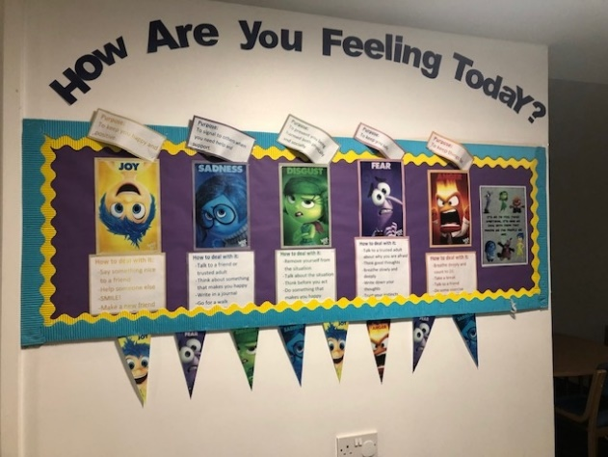
Case study: Secondary with CLA and PCLA
Our school has a rich diversity which was established over 80 years ago with just 5 students. It is now a thriving learning community with 985 students and 100 staff. As a faith school, our ethos permeates all that we do,and is reflected in our Mission Statement ; “we aim to create a happy family environment in which all may grow: In faith, hope and love for God, in love and respect for one another and the world around us, in learning and wisdom so that we may live life to the full and joyfully share this life with others, especially those who are in anyway disadvantaged.”
The nurturing environment of our school is clearly demonstrated in our consistently high Progress 8 scores. The well-being of the overall pupil is paramount. However, if we can provide them with excellent grades then their life opportunities are significantly enhanced.
The key issues that needed to be addressed and were identified through the Achieving Wellbeing CLA Review and the Designated Teacher Self Evaluation:
Initial needs analysis and coaching conversation
Identification of target pupils
Working effectively with parents/ carers
CPD and raising greater awareness for staff
More effective writing of PEPs
Coaching of individual complex cases for DT.
Notes:
40

Slide 41
What we did
Initial needs analysis and coaching conversation
Pupil voice using a STEEP analysis
Actions as a result of pupil voice, e.g. curriculum.
Parent/carer forums
Actions as a result of parent/ carer forum
CPD for staff on CLA, PCLA, attachment and ACES
Follow up on CPD as a result of initial session (staff briefings, poster in staff room and 1:1 sessions)
Continued pathways for communication with parents/ carers
Mentoring to make PEPs more effective.
Consideration about what makes a safe adult and a safe place and ensuring this was explicit to all.
Notes:
11.55

Slide 42
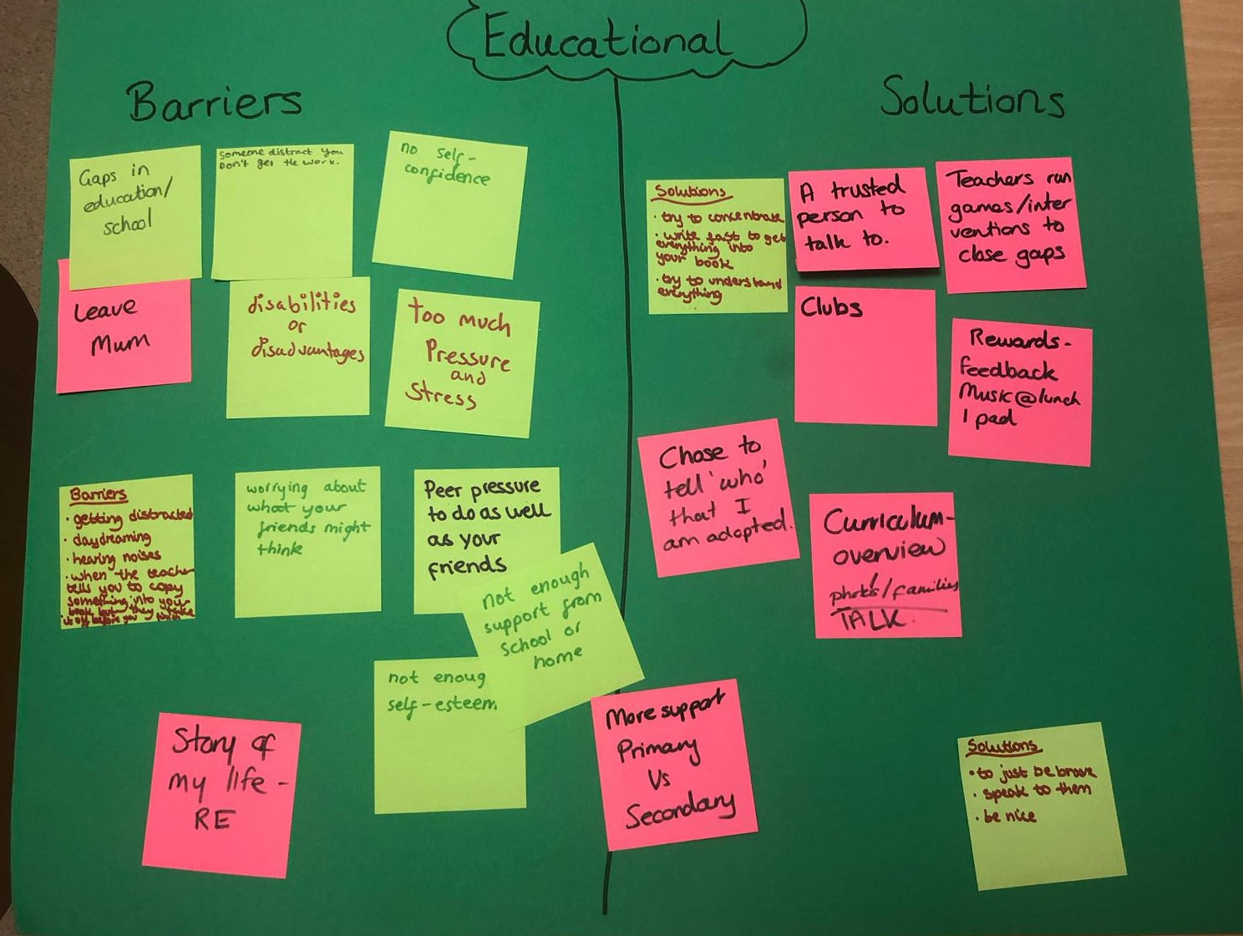

Slide 43
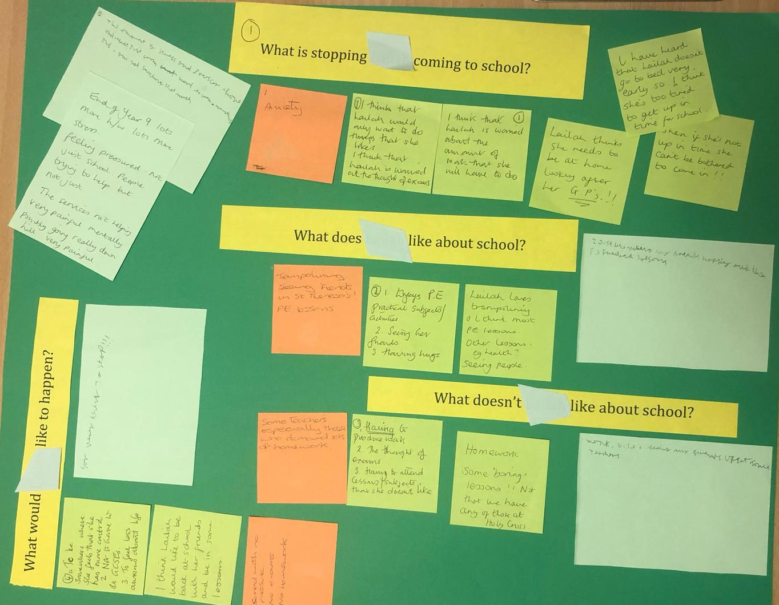

Slide 44
Impact
Following the creation of parents/ carers (PCLA/CLA) forum one parent said " Thanks so much for this, it means a lot to us adopters/ carers that we are getting so much support and understanding from yourself and the staff around the issues and concerns we have in bringing up our sometimes complicated but always lovely children!”
Notes:
12.00

Slide 45
Another said "Thank you for al most inspirational evening and a great reminder of the importance of listening. I would like to thank you for your huge acknowledgement of our children's' needs (which in a way can be seen as hidden disabilities) and being instrumental in helping our girls weather the storms of secondary school where they will encounter many interactions especially with peers as rejections. For our girls these perceived rejections can trigger a host of emotional reactions and it is the wonderful scaffolding that you are putting in place to hold them that will be their saving grace. Our daughter, feels secure, happy and at home at Holy Cross school and this I feel is mainly down to how you have welcomed and supported her. She feels heard and respected, as do I as a parent. So a big thank you to you all."

Slide 46
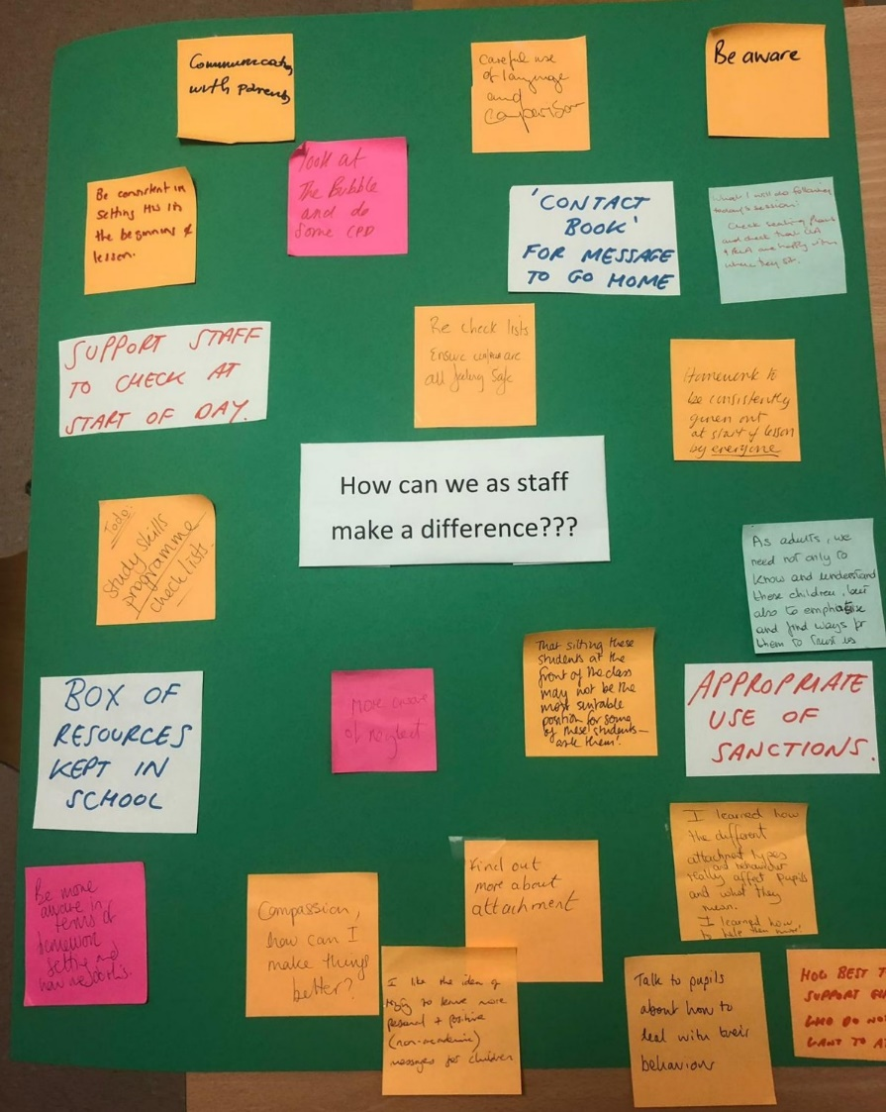
Staff input during the
CPD November 2019

Slide 47
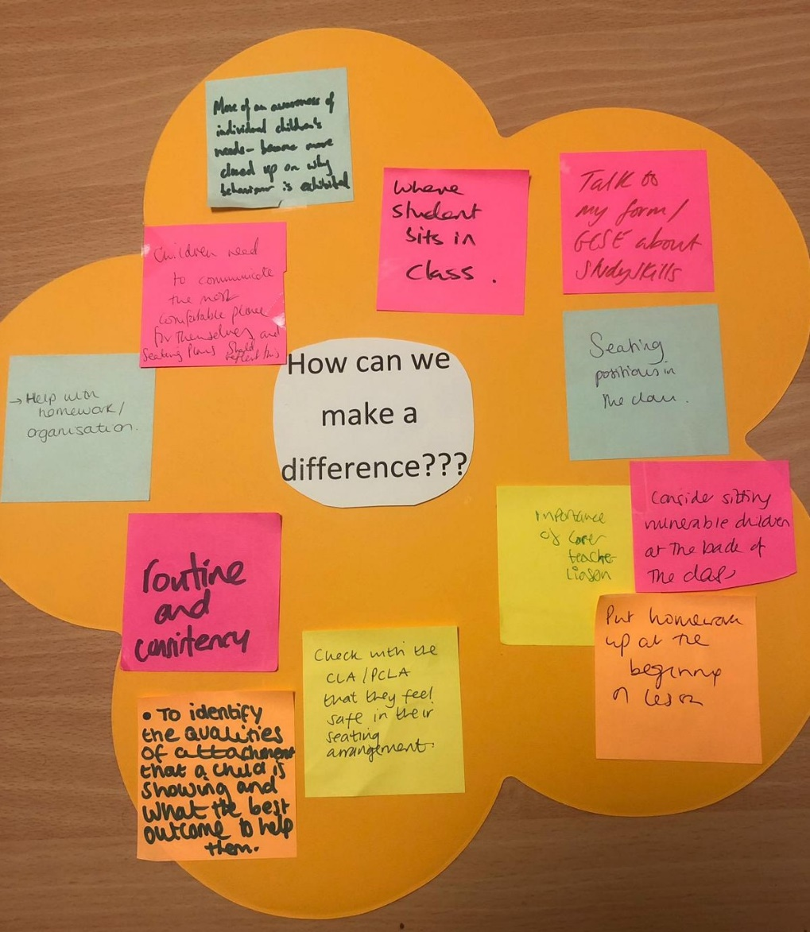

Slide 48
Impact Profile of CLA/ PCLA has been raised and a greater understanding of their needs and how this impacts on their everyday life at school. Staff have a broader range of strategies to meet their needs. Designated teacher feels a need has been met that they have wanted to be more proactive in meeting these needs. She can see positive impact on individual pupils as a result. She also feels she is doing more with the whole cohort of children. Progress for CLA has been very positive across the board. They feel supported, with staff sensitively providing for needs. Self-esteem for CLA/PLCA has improved. Transition for Y7s was smooth due to good communications and understanding.
Notes:
45

Slide 49
Q and A
https://afaeducation.org/free-dt-resources/

